Slide 1


Human - Computer
Interaction
Present by Chi Nguyen

Slide 2
CONTENTS OF THIS WORKSHOP
Introduction
  What are UX and UI design?
  Why UX design is important?
  The career in UX/UI design
Principles for UX design
Process of UX/UI design
Tool & software in UX/UI
Bad or Good design?
Question and Answer

Slide 3

WHAT ARE
Looks
Feels
Interacting
Experience
User Interface
User Experience

Slide 4
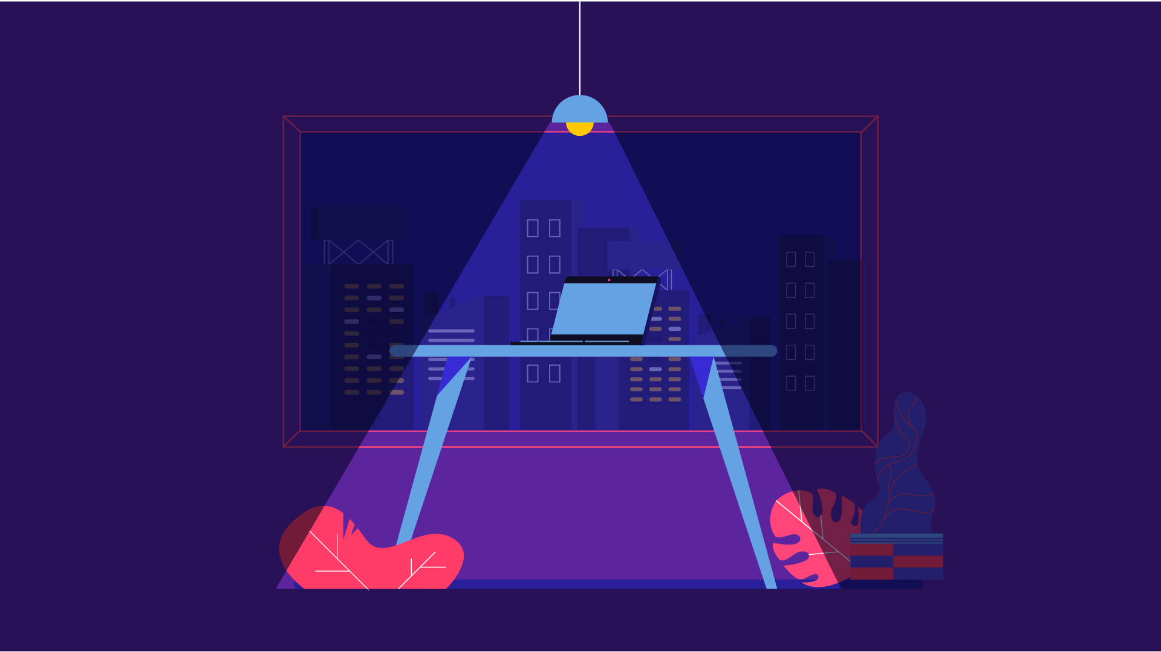
WHY UX DESIGN IS IMPORTANT?

Slide 5
WHY UX DESIGN IS IMPORTANT?

Slide 6
Do you want to buy it?
Do you want to delete/ replace it?
No
Yes
No
Yes

Slide 7
WHY UX DESIGN IS IMPORTANT?
Investing in UX design upfront can significantly reduce costs down the line
User Experience can help you increase your conversions
UX design can help with your SEO
Increase your brand loyalty with UX design
UX design can help increase word of mouth referrals
It helps you solve your users problems
You can make a difference
You can create interesting content

Slide 8
THE CAREER IN UI/UX DESIGN
UI
designer
UX
designer
THOUGHT PROCESS
Critical thinking
Art direction
VISUAL STRENGTHS
Color
Typography
THOUGHT PROCESS
Critical thinking
Creative thinking
VISUAL STRENGTHS
Task flows
Scenarios
DESIGN PRINCIPLES
Visual design
DESIGN PRINCIPLES
Human centered design
EXPERTISE
Mockups
Graphics
Layouts
EXPERTISE
Wireframes
Prototypes
Research
SOME OTHER ROLES
Graphic designer
Brand designer
Web designer
SOME OTHER ROLES
Information architect
Content strategist
Functional analyst
Presentor & Consultant

Slide 9
THE CAREER IN UI/UX DESIGN
Interaction designer
UI
designer
UX
designer
Product designer

Slide 10
02
PRINCIPLES FOR
UX DESIGN
User-centered design
Context
Hierarchy
Empathy Mindset
Eye-tracking
Storyboard
User stories
Information artchitecture
Accessibility
Confirmation
Consistency
More easy access
More good product
Avoid user’s pain by accidentally click/ press
Design guidelines

Slide 11
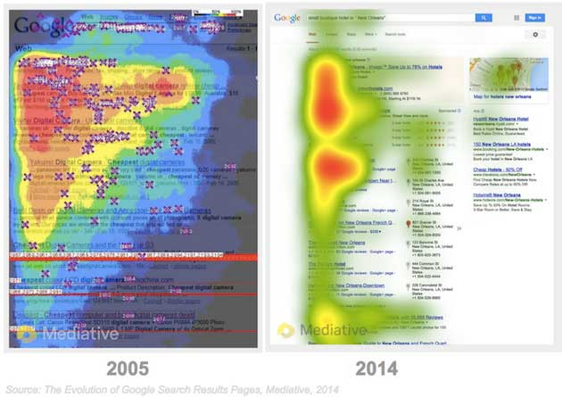
Eye-tracking

Slide 12
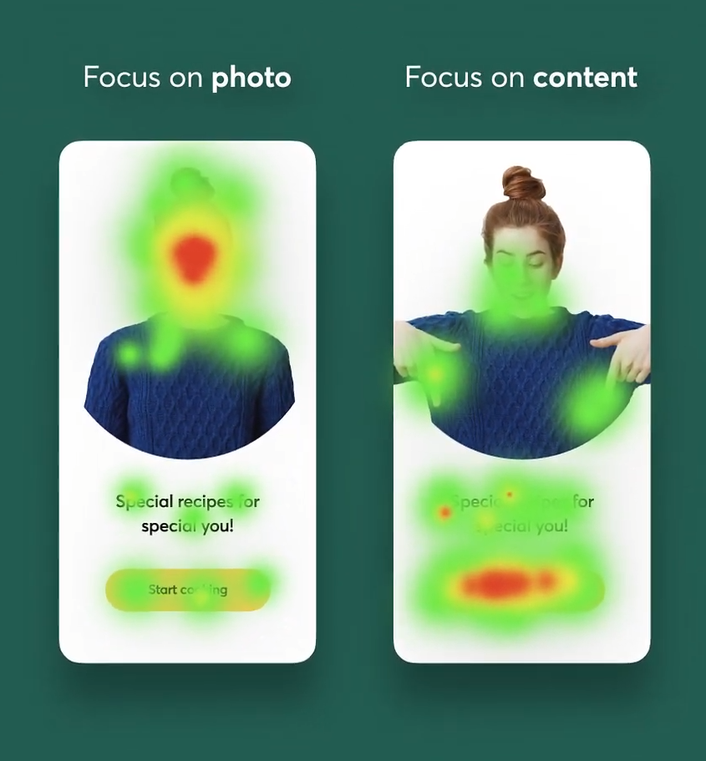
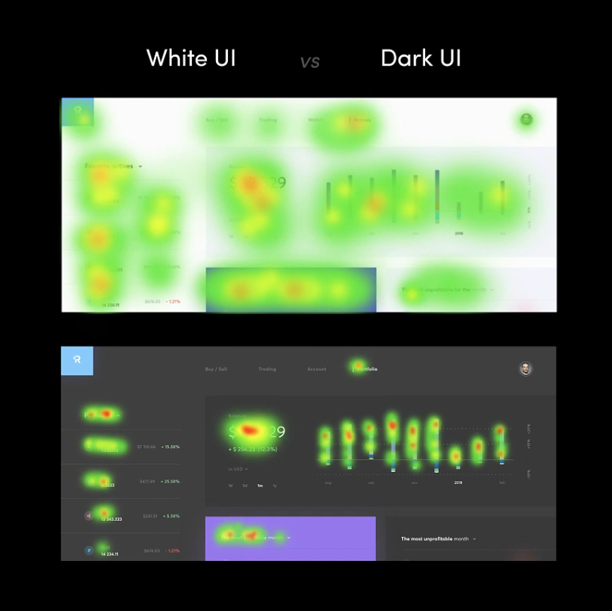

Slide 13
02
PRINCIPLES FOR
UX DESIGN
User-centered design
Context
Hierarchy
Empathy Mindset
Eye-tracking
Storyboard
User stories
Information artchitecture
Accessibility
Confirmation
Consistency
More easy access
More good product
Avoid user’s pain by accidentally click/ press
Design guidelines

Slide 14
Process
Of
UX/UI
Design
03

Slide 15
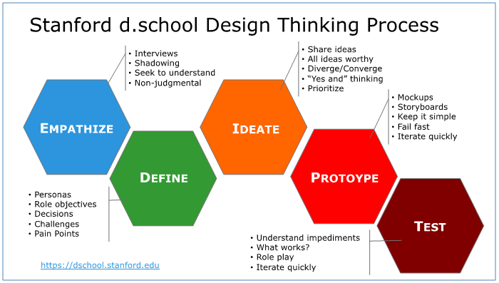
03

Slide 16
03
PROCESS OF UX/UI DESIGN
Use
cases
User
stories
Flow
Customers
Visual
style
Mockup
Usibility test
Brand
Goals
RESEARCH
(brief)
INSIGHT
&
ANALYSIS
UX
(Concept/
Ideate)
UI
DESIGN
DEVELOP
Business
Vision
Wireframe
Prototype
Personas
Motion
design
Graphic quality check
PRESENT TO CLIENTS & TEAM
Dev Back-end
UI designer
Dev Front-end

Slide 17
TOOLS
RESEARCH | INSIGHT & ANALYSIS | UX DESIGN | UI DESIGN | DEVELOP
Brief | Empathy map | Task flows | Brand guidline | Test case
Materials | Storyboard | Content architecture | Design system | A/B test
Mindmap | Moodboard | Prototype | Visual style direction | Graphic check-list

Slide 18
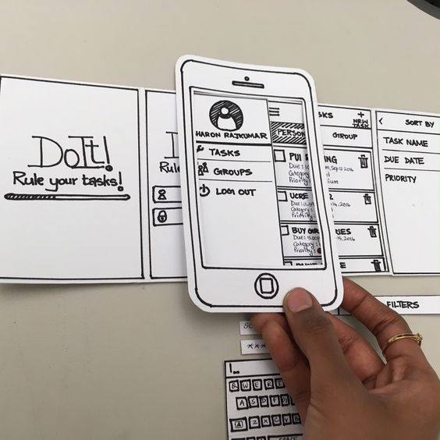
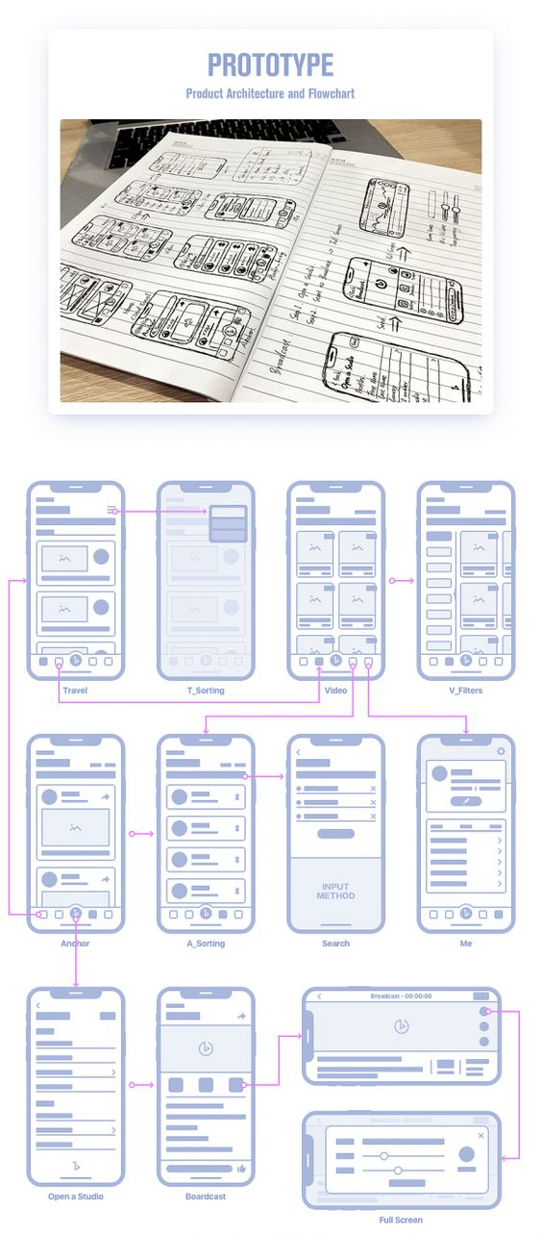

Slide 20
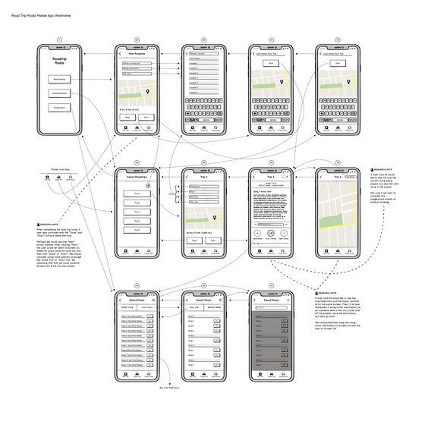

Slide 21
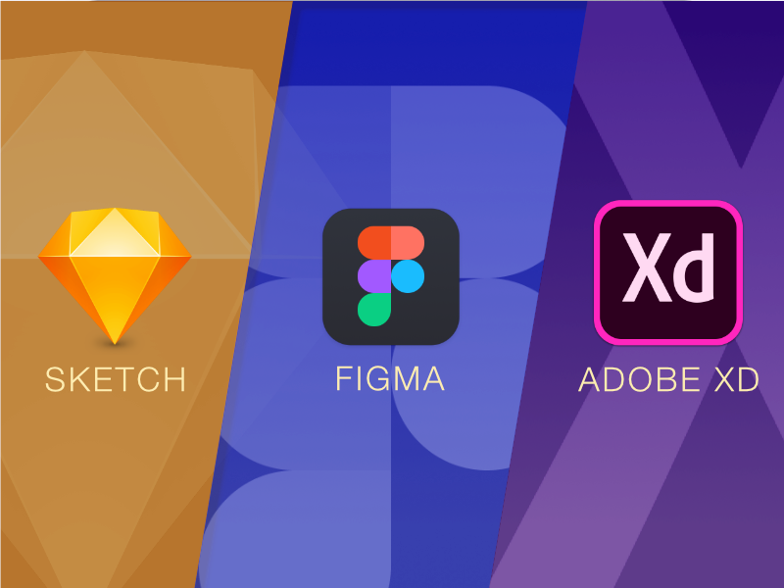
SOFTWARE

Slide 22
BAD or
GOOD
DESIGN

Slide 23
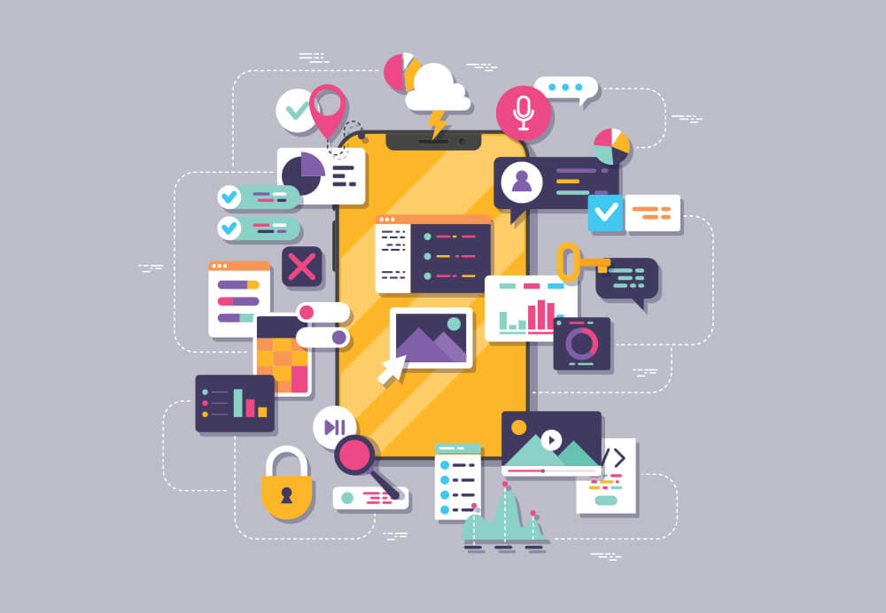
the less the more

Slide 24
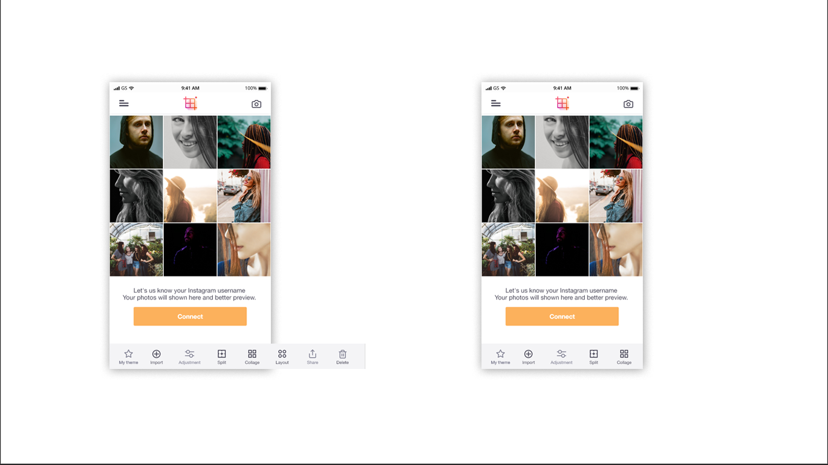
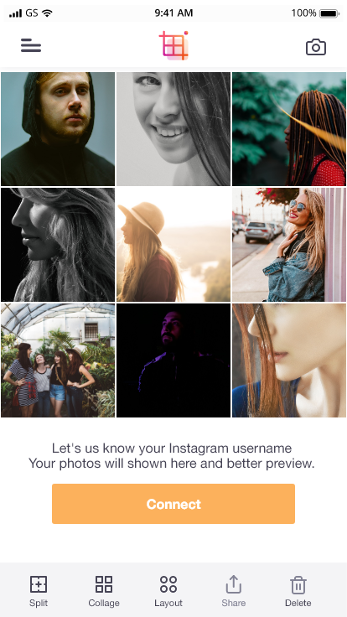

Slide 25
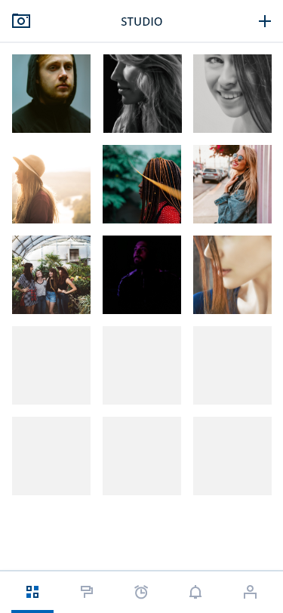


Slide 26
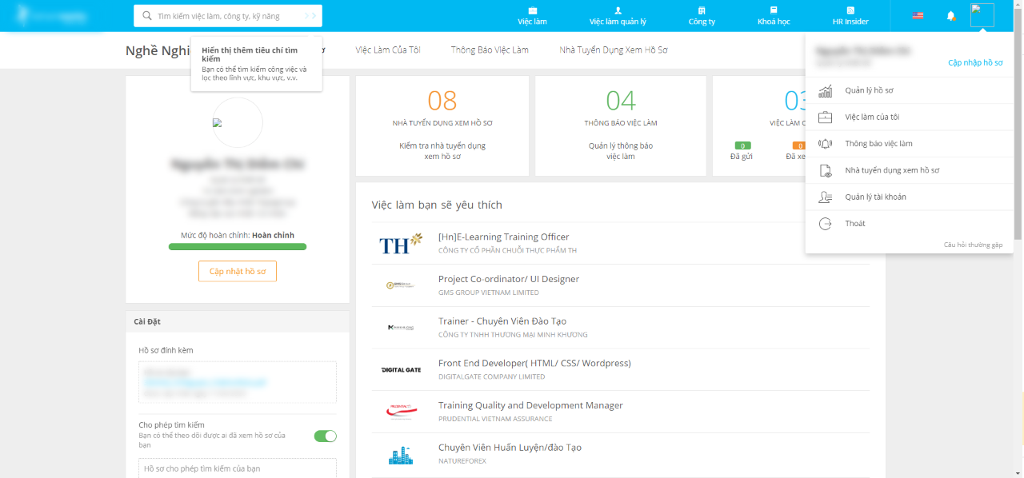

Slide 27
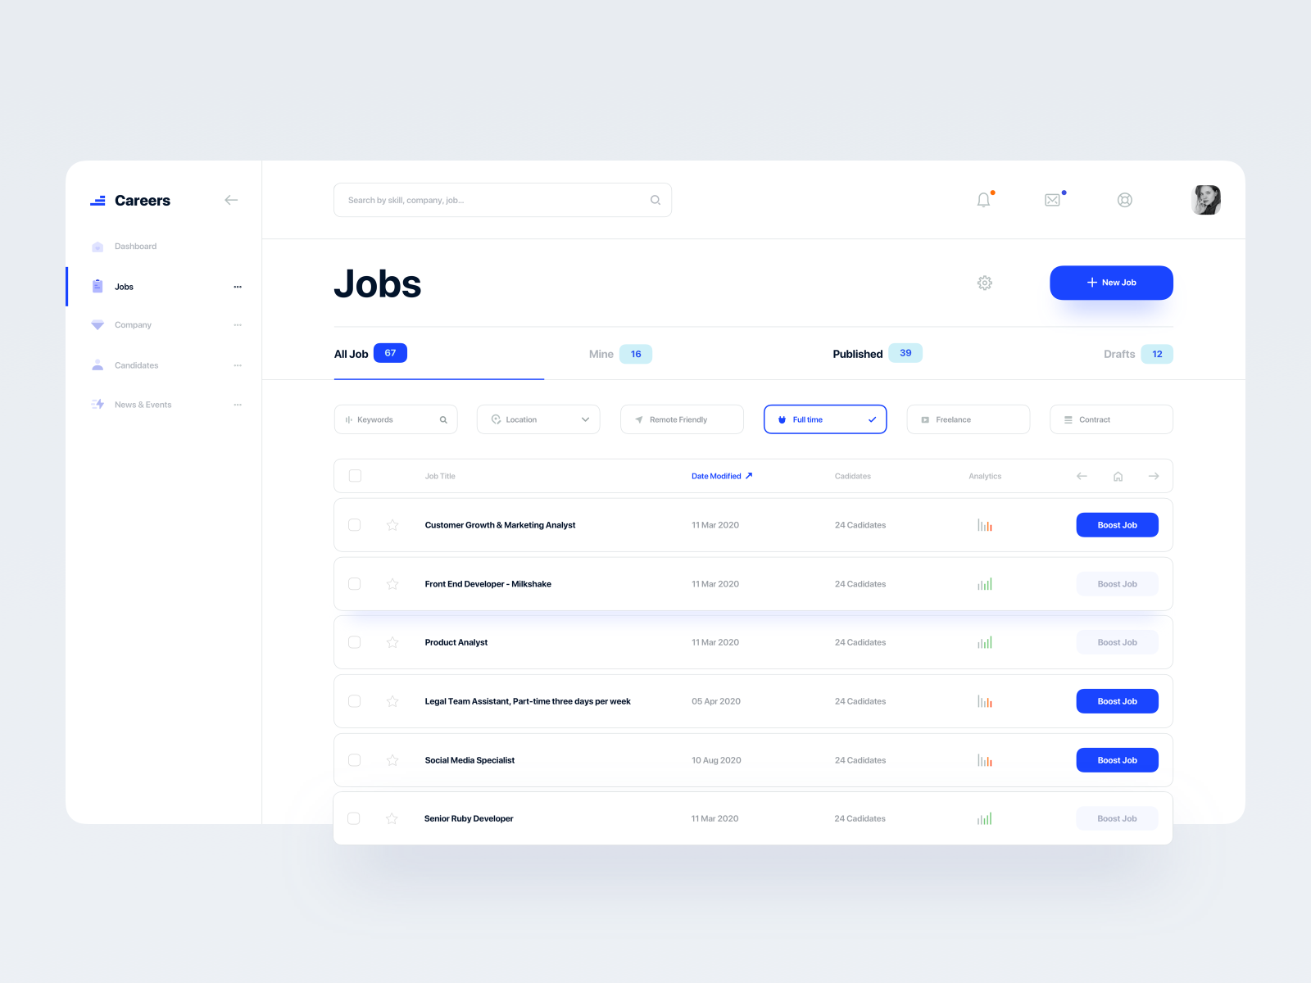

Slide 28
ACCESSIBILITY/
USABILITY
CALLING ACTION
REACTION /
FEEDBACK
There’s no way to convience user when they can’t use it.
Clear messages and calling action when we need their action.
When users action, let them know that it works or not.
Don’t let them waiting in the confused

Slide 29
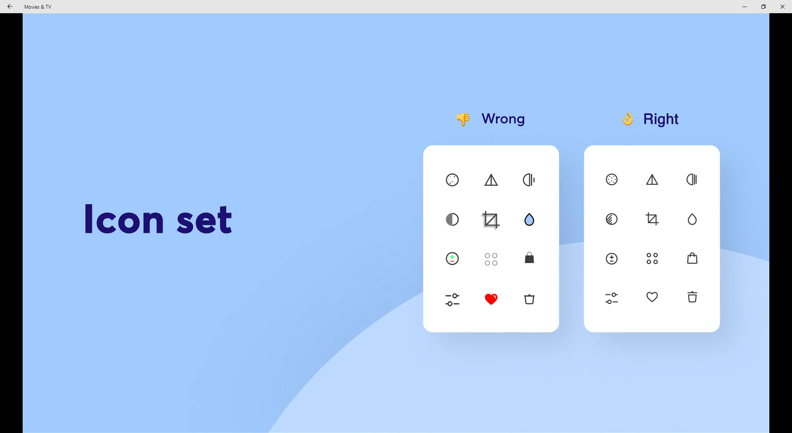
CONSISTENCY

Slide 30
UPDATE
NEW
TREND
TREND

Slide 31


Thanks!
Do you have any questions?
chrizmonkey@gmail.com
+84 0937 566 561

